Slide 1

Adult Income Prediction
Above and below 50k
Aaron Carney
Springboard 12/21

Slide 2
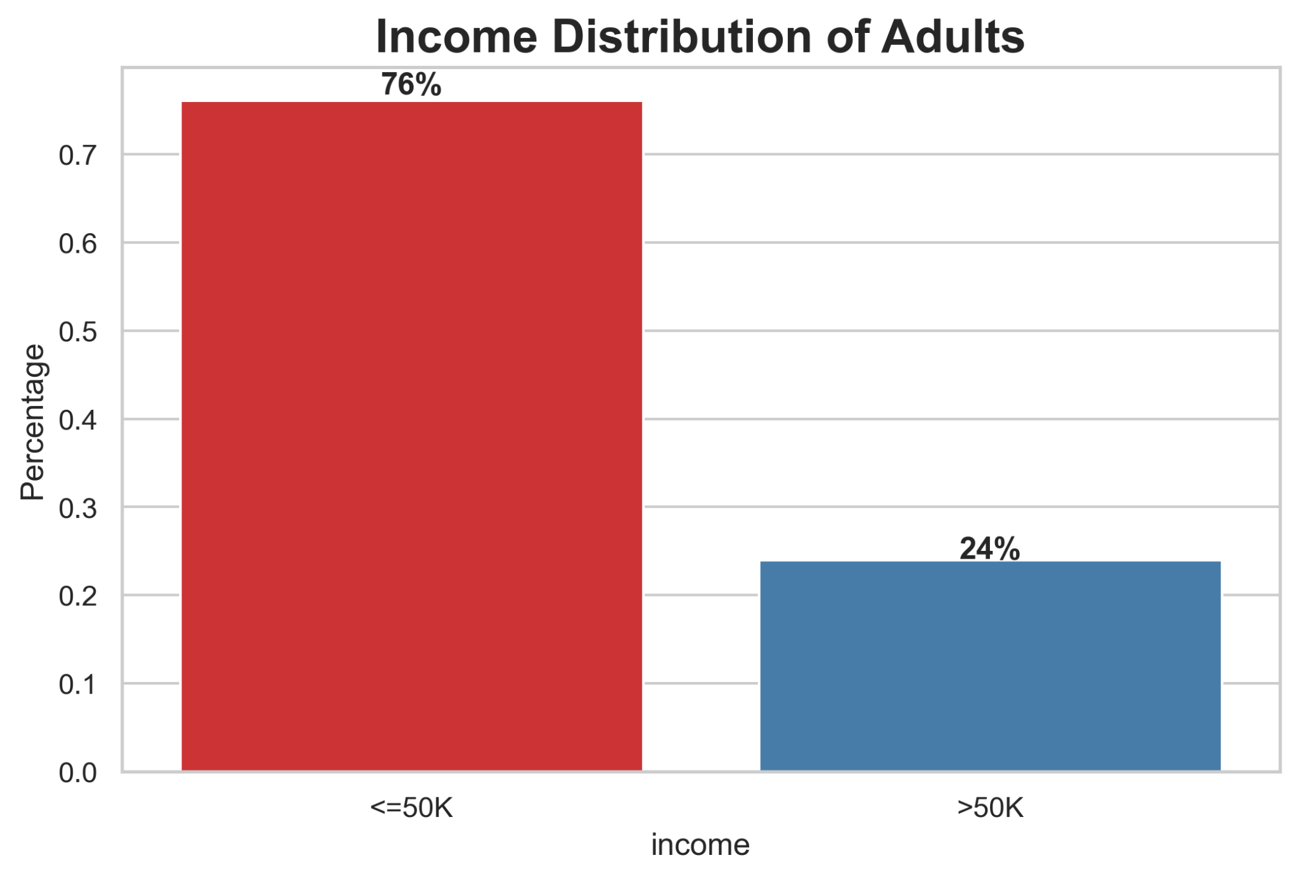

Slide 3
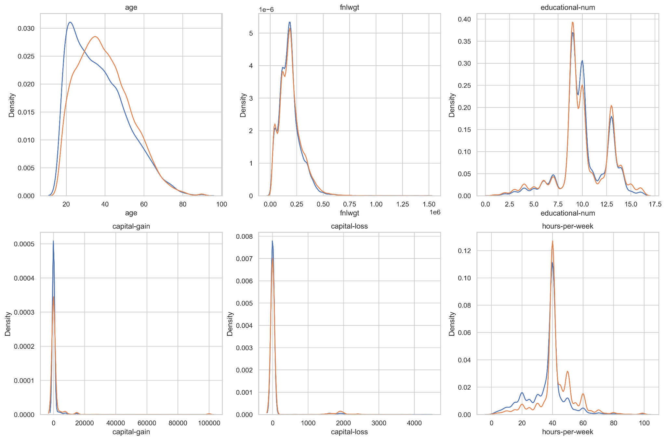
Numerical Correlations

Slide 4
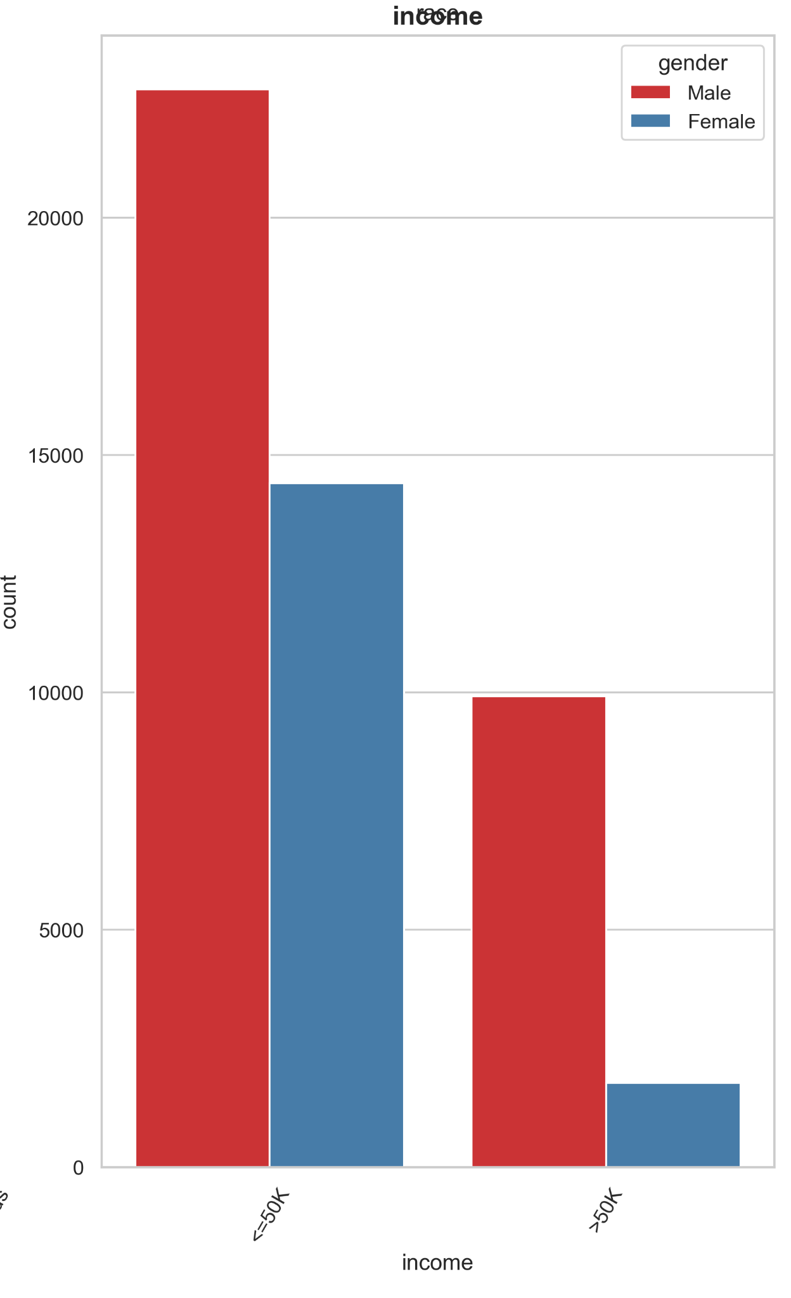
Raw:
Male : 30% earn >50K || 70% earn <=50K
Female : 11% earn >50K || 89% earn <=50K
Normalization:
Earning > 50K : 58% are Females and 42% are Males
Earning =< 50K : 28% are Females and 72% are Males

Slide 5
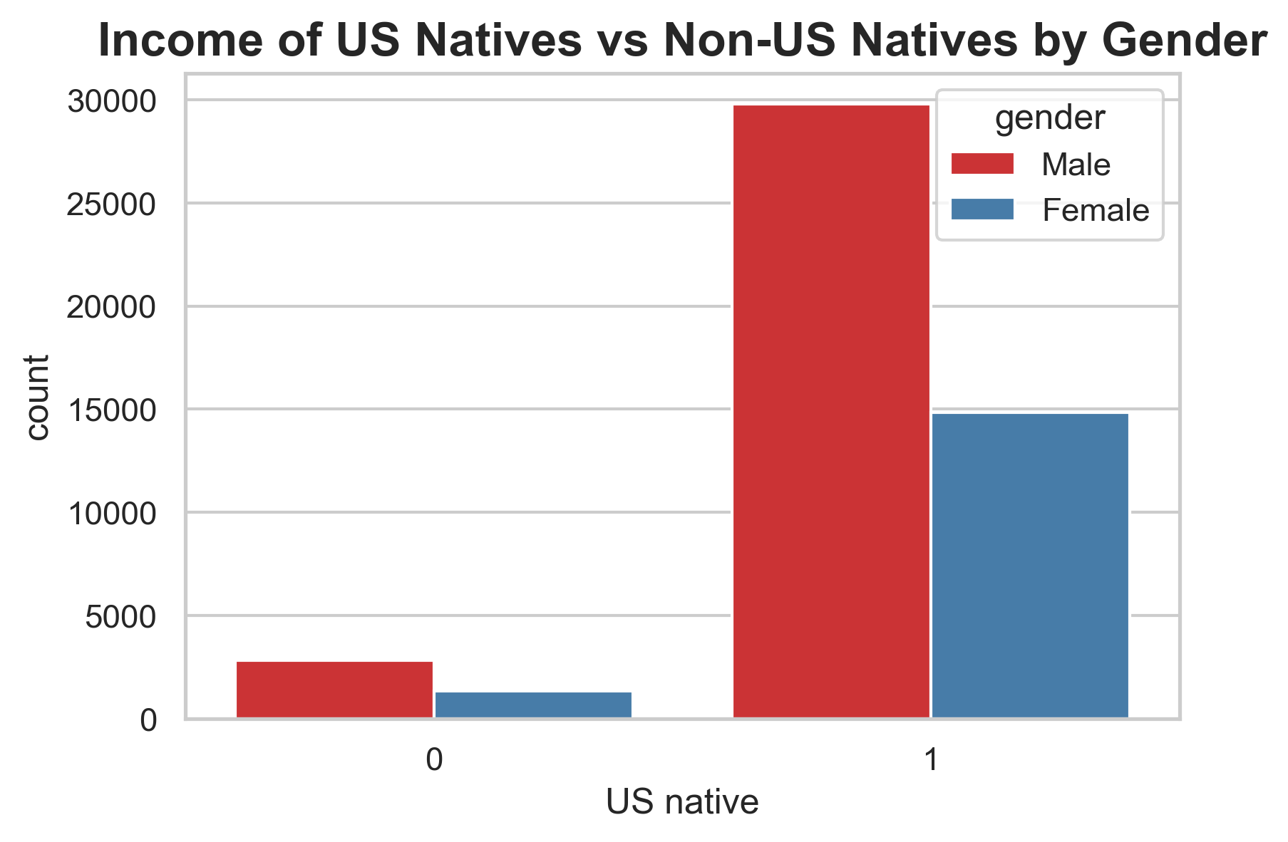
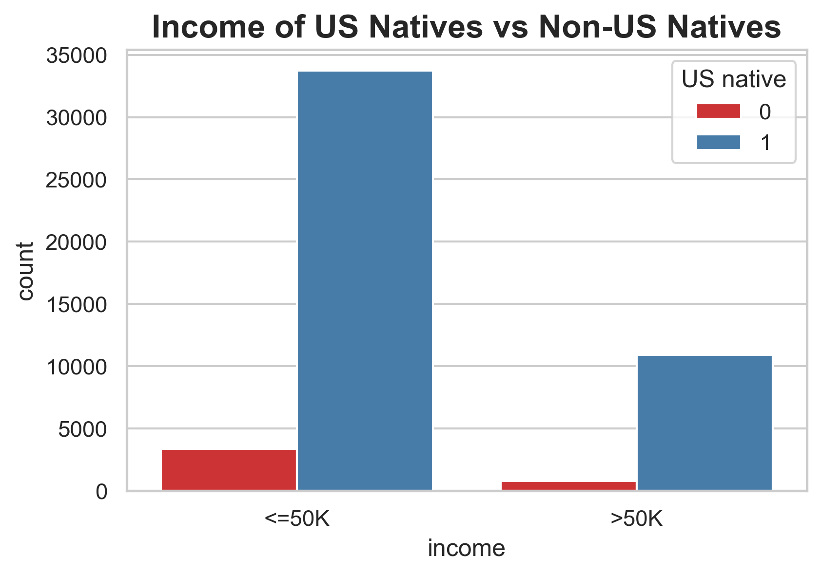

Slide 6
Raw:
Among Natives : 24% earn >50K and 76% earn <=50K
Among Foreigners : 19% earn >50K and 81% earn <=50K
Normalized:
Earning > 50K : 57% are natives || 43% are foreigners
Earning =< 50K : 48% are natives || 52% are foreigners

Slide 7
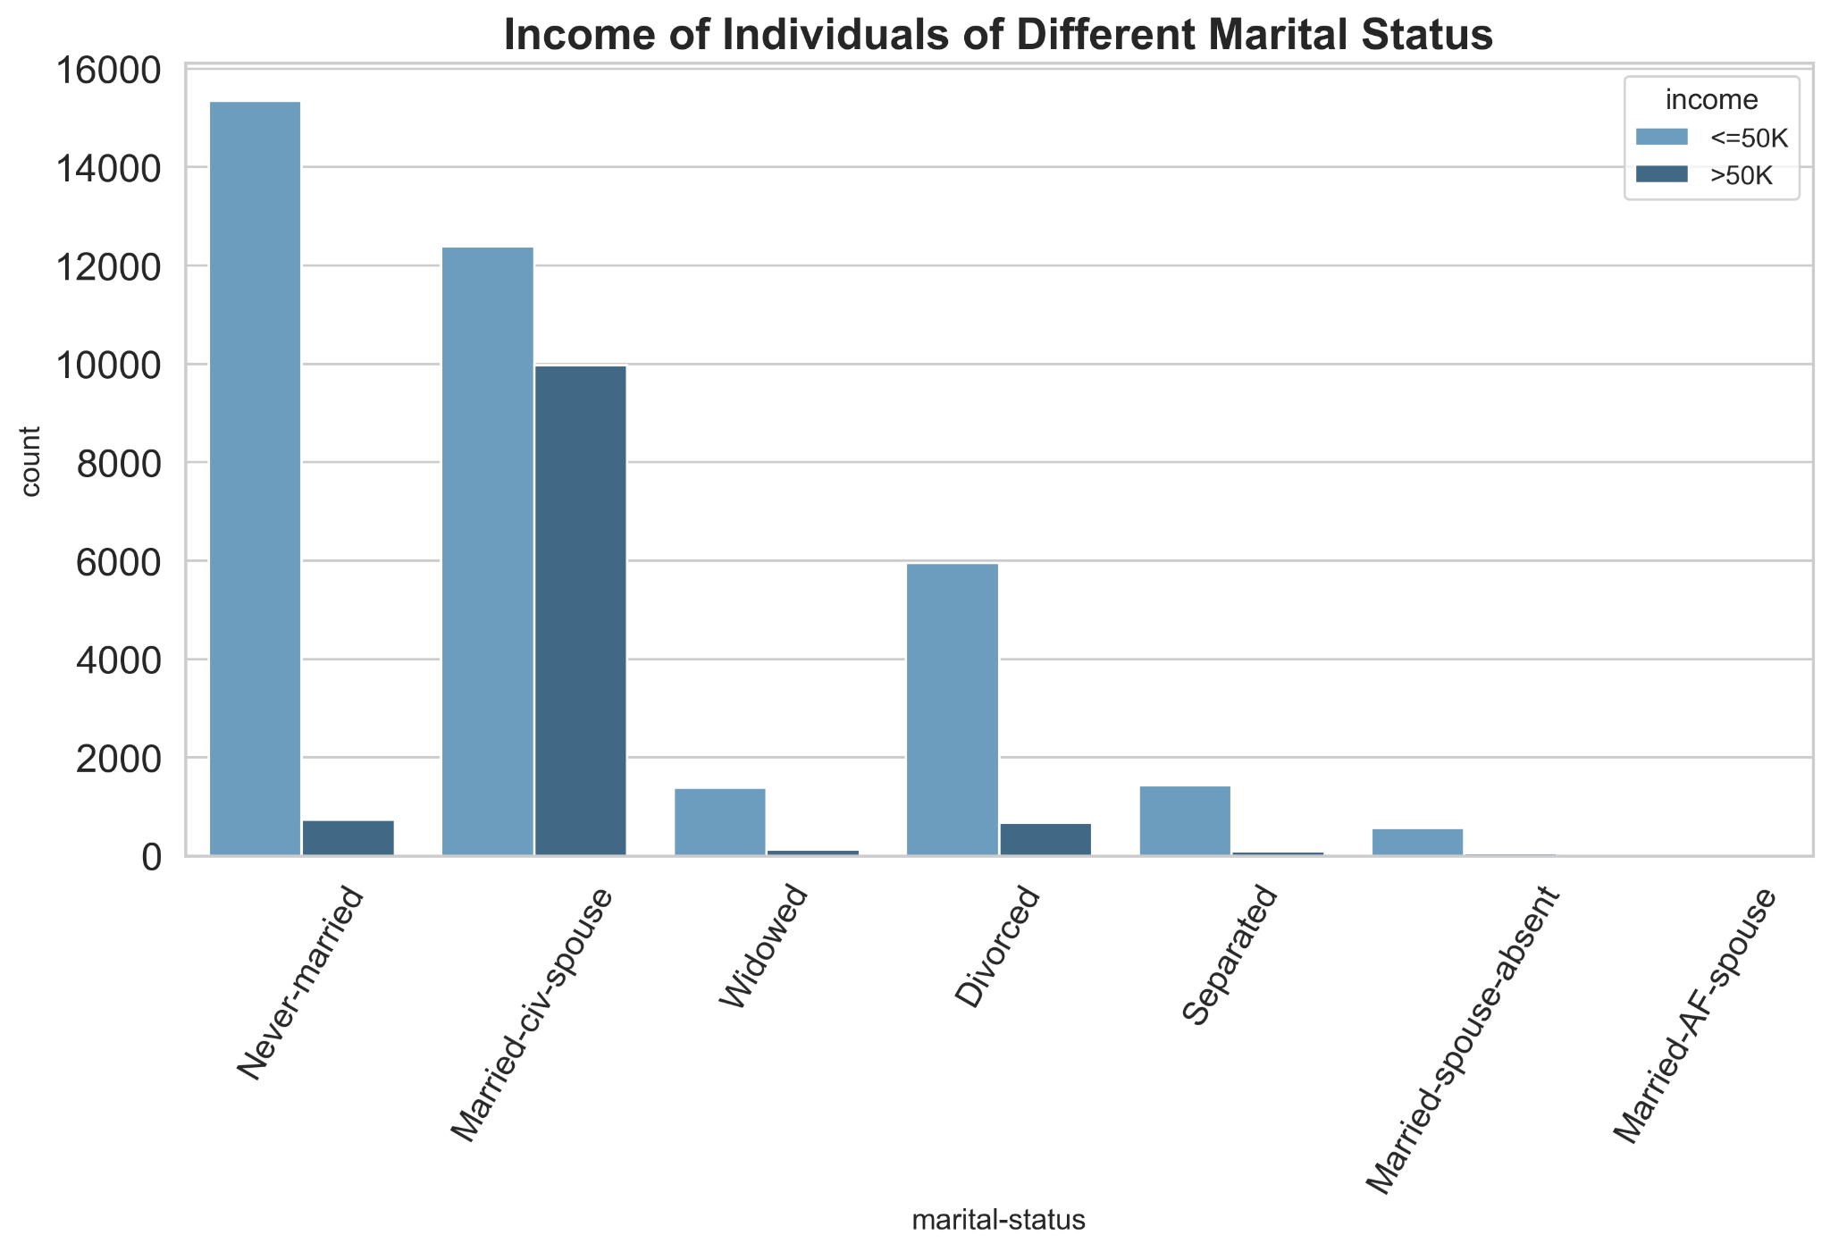

Slide 8
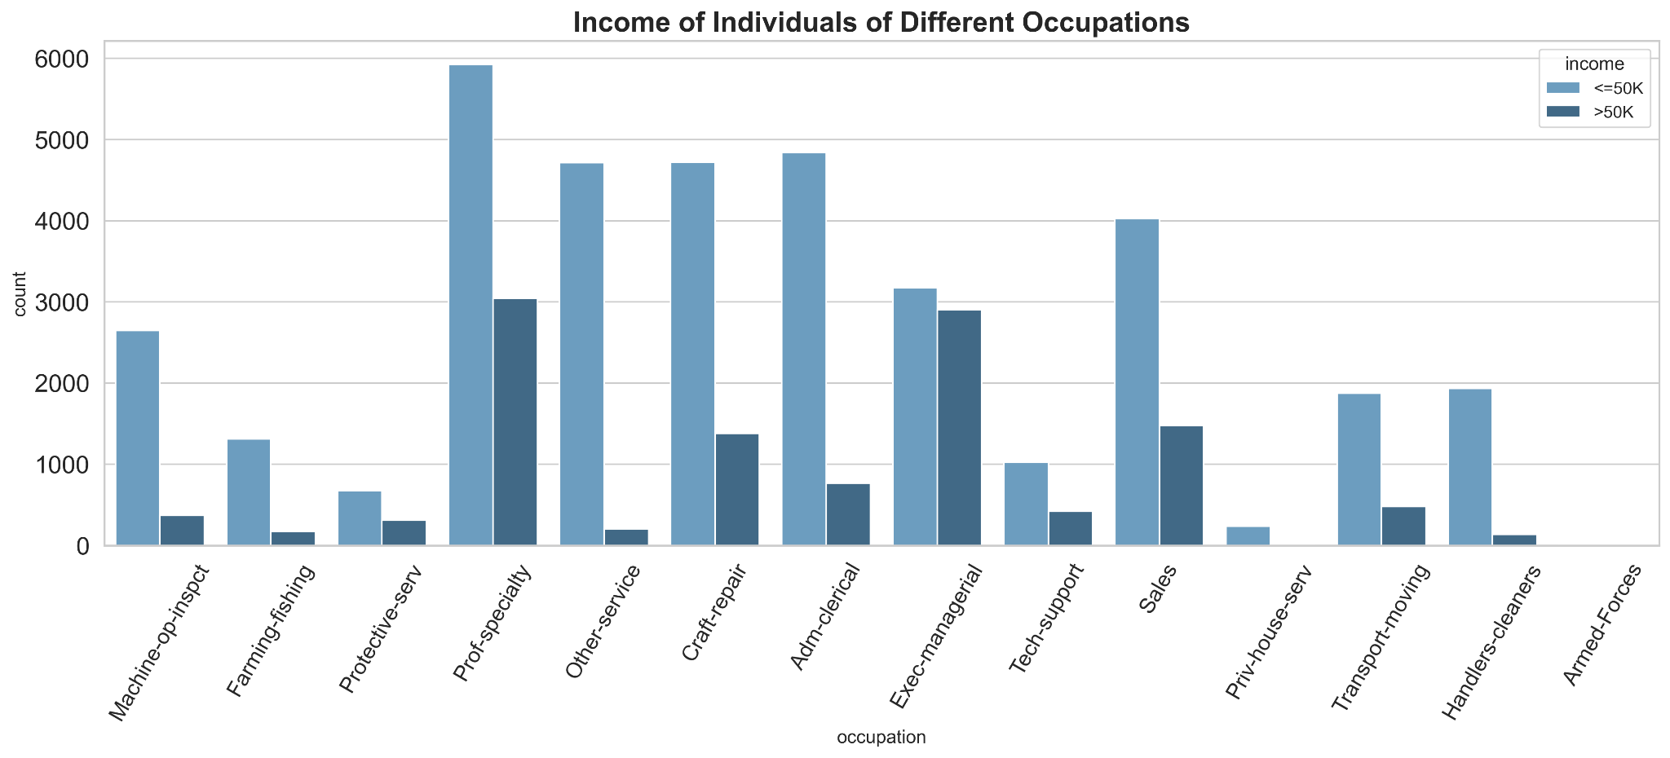

Slide 9
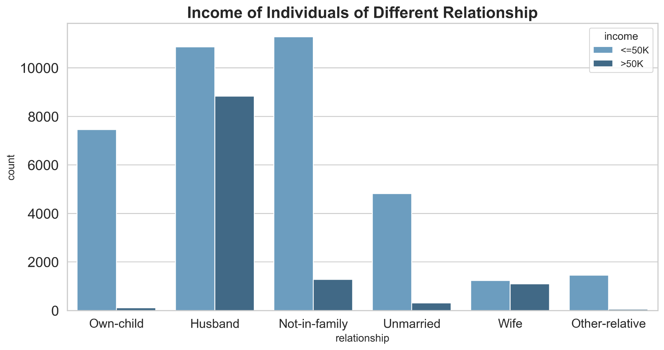

Slide 10
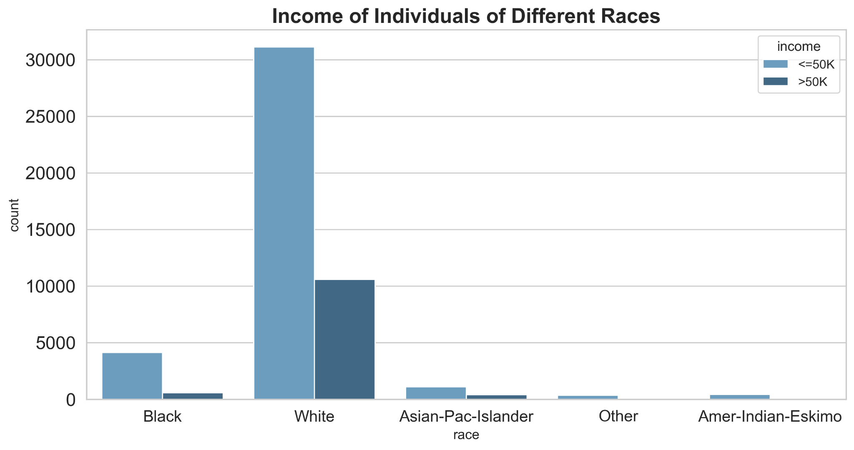

Slide 11
